Slide 1
NLH Progress Update: Pure fitting and Mixture coding
Full collaboration group meeting
02/01/2023

Slide 2
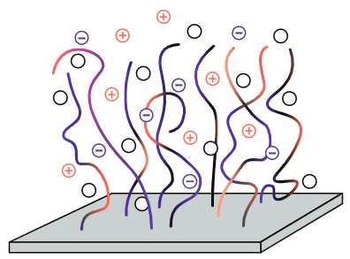
Model Overview
Interactions:
Flory Huggins (2-body) between solvent and monomers
Elasticity between monomers of the same chain
Electrostatics between all (charged) monomers and ions
For brushes with multiple components (L-H, L-M):
Coarse-grained stiffness value (b) for each protein
Monomer volume (v) for each protein
But, same FH \chi parameters for each amino acid
Simple model protein brush
Insert FH Equation with v_i

Slide 3
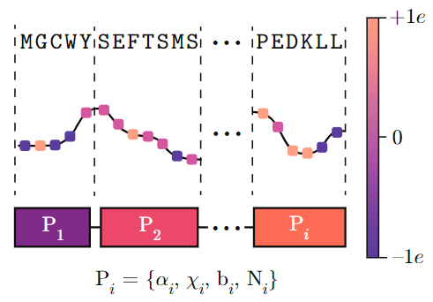
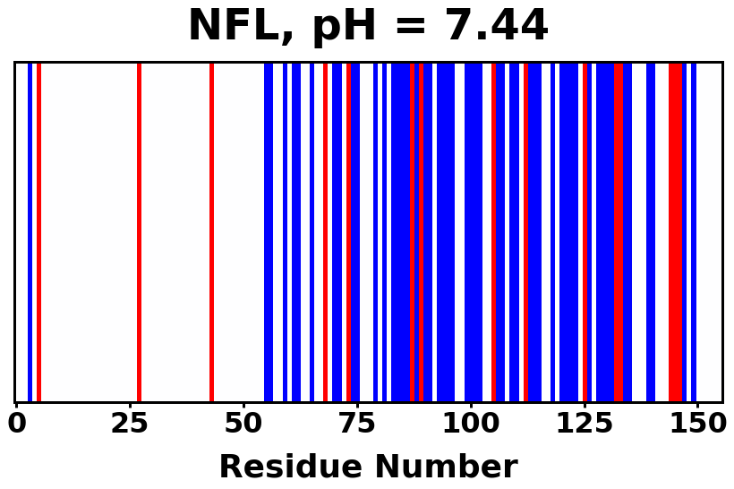

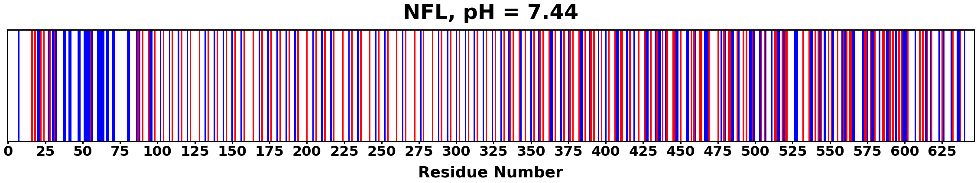
Protein Charge Distribution
Amino acid
Algorithm overview
Charge (at given pH)
Block assignment
> 0e
NFL, pH 7.44
= 0e
< 0e
> 0e
NFH, pH 7.44
= 0e
< 0e

Slide 4
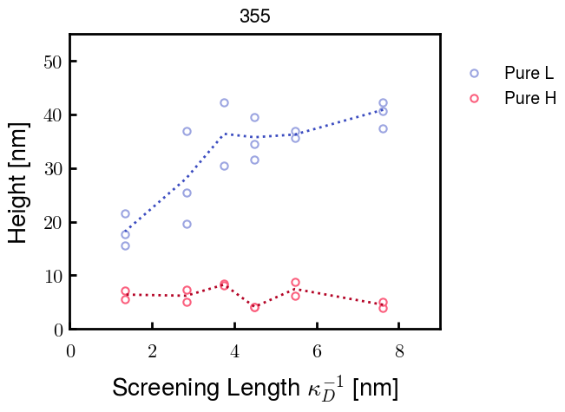
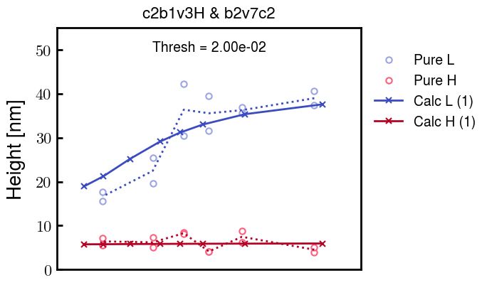
Fitting pure NFL and NFH
Experimental Data from Erika
Calculated Heights from SCFT
Outdated

Slide 5
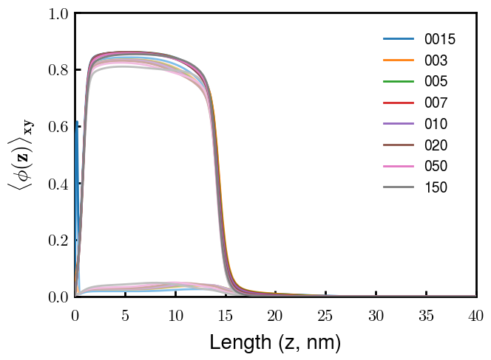
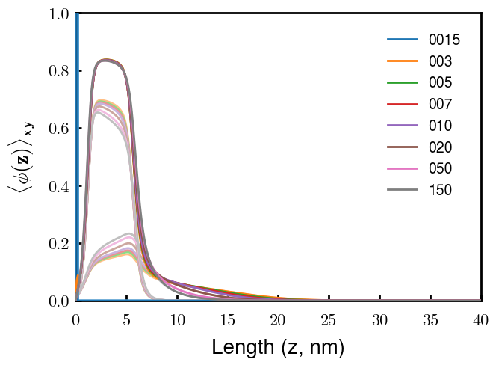
Mixture of NFL and NFH (by mol fraction)
30% L
80% L
Overall
Overall
NFH
NFH
NFL
NFL

Slide 6
Next Steps
Fine tuning of parameters for best fit with height profile of mixtures
Charge of heterogeneous negative block of NFH (blocks 2 & 3)
L-H brushes after phosphorylation
L-M brushes (once experiments are finished)

